Slide 1
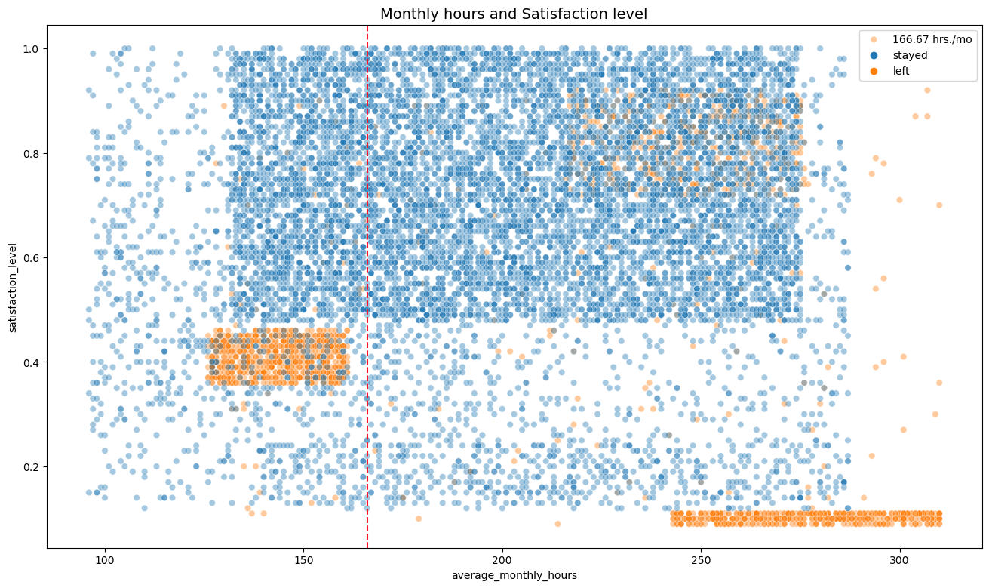
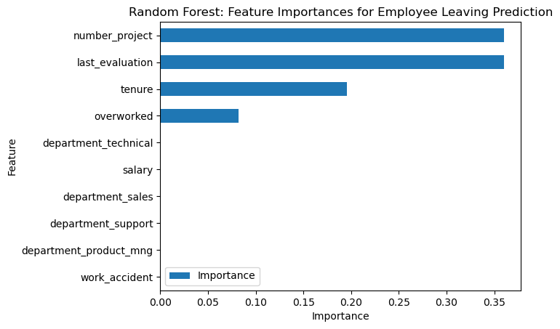
Salifort Motors
Employee Retention Project - View at my Portfolio
Sailfort Motors has been experiencing a high turnover rate of employees . The company wants to identify ways to improve employee retention and identify what causes employees to leave.
For a categorical response, a linear regression model, decision tree and random forest were built. Results were evaluated and the random forest was the champion model.
The EDA and feature importances were also interpretted for valuable insights.
From the EDA, the scatterplot shows the decrease in satisfaction as more monthly hours were rendered. Leavers were grouped according to likely reasons (full insights on the Jupyter Notebook).
The random forest model performed great on the test data based on various metrics, and is able to predict leavers based on the given data. Feature Importances also give great insight on courses of action to take to retention.
The champion model, in the random forest model above, showed, `number_project`, `last_evaluation`, `tenure`, `overworked`, have the highest importance. These variables are most helpful in predicting the outcome variable, `left`.
Workload - Equally distribute workload between workers, (between 3-4 projects only).
- Reduce monthly hours rendered, through automation, improved systems or workflow
- Conduct interviews on most time consuming areas of work.
- Make sure new employees understand hourly expectations before hiring.
- Reward employees working overtime via pay, benefits or bonus.
Evaluation - Identify effect of low evaluation to quitting, is pay reduced? Does this lead to firing?
- Avoid reserving high evaluation for 200+ hrs rendered, consider a bonus or incentive system instead.
- Utilize model to predict potential leavers, and create an intervention/reward program for employees.
Identify Causes - Identify via interviews, cause for lower satisfaction on tenures 5-6, and leaving in year 4.
- Consider promoting or salary increase for on their 4th year (at ensure promotion within 5 years).
- Conduct internal surveys, FGDs and team meetings to check on employees workload and well-being.

